Slide 1
Deutsch 1
Lesson 6
den 30. April 2014

Slide 2
Revision
What do all German nouns have in common?

Slide 3
Was kostet…?
Person A: Was kostet die DVD?
Person B: Die DVD kostet €9,99.
See textbook page 26 for genders.

Slide 4
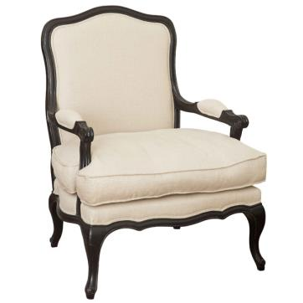
Was kostet…?

Slide 5
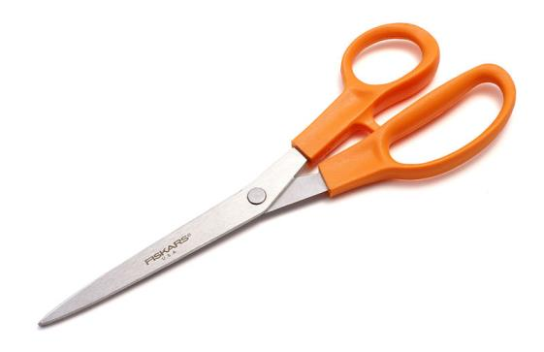
Was kostet...?

Slide 6
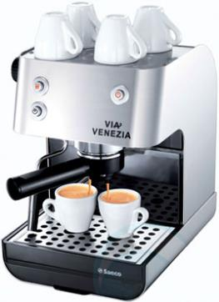
Was kostet…?

Slide 7
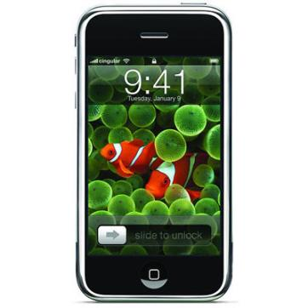
Was kostet...?

Slide 8
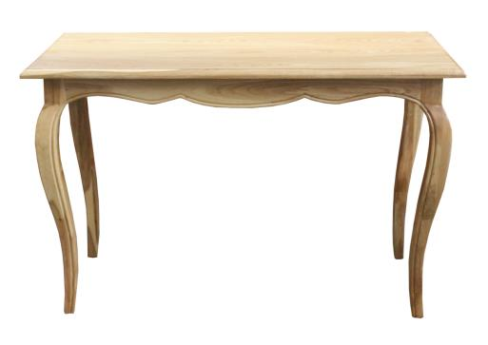
Was kostet…?

Slide 9
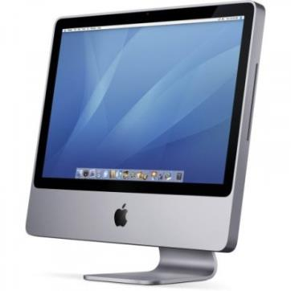
Was kostet…?

Slide 10
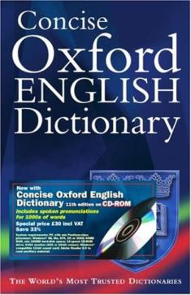
Was kostet…?

Slide 11
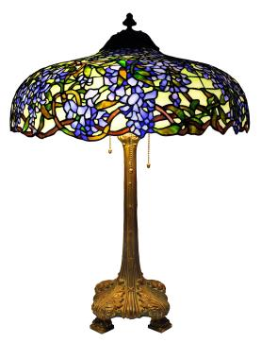
Was kostet…?

Slide 12
Was kostet…?

Slide 13
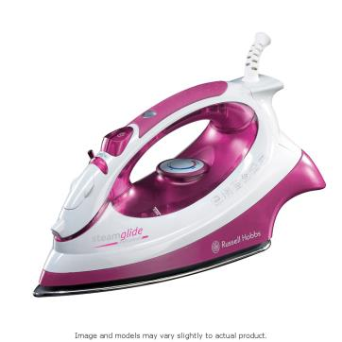
Was kostet…?

Slide 14
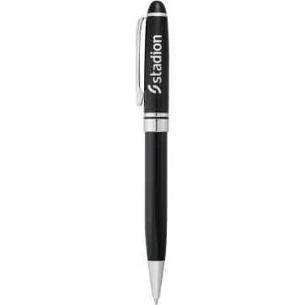
Was kostet…?

Slide 15
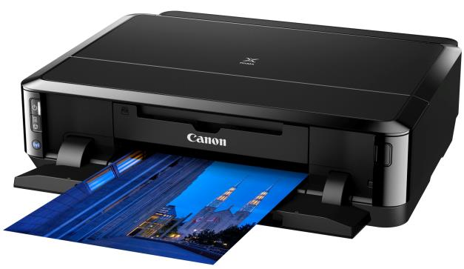
Was kostet…?

Slide 16
Textbook page 28
Activity 4 all

Slide 17
Textbook page 88
All.

Slide 18
Textbook p 88 #3
Der Familienname
Die Adresse
Das Land
Die Telefonnummer
Die Sprache
Die Lehrerin
Der Kaffee
Der Tee
Die Milch
Der Zucker
Das Mineralwasser

Slide 19
ein/kein/mein/dein
ein – a/an
kein – no (an amount, rather than the opposite of yes)
mein – my
dein – your
These articles are dictated by the noun that follows them and their ending changes according to the gender of that noun.

Slide 20
ein/kein/mein/dein - genders
In the nominative case (we’ll worry about what that means later), these articles stay the same if the noun that follows them is MASCULINE (der) or NEUTER (das).
eg der Name ➔Wie ist dein Name?
The articles will get an –e ending if the noun that follows them is FEMININE (die).
eg die Telefonnummer ➔ Wie ist deine Telefonnummer?

Slide 21
Textbook page 29
Activity 5a – Listening
Activity 5b – Using items from textbook p 26.
Activity 6b.
Activity 6c – Write about 3 objects, 2 sentences per object. I will collect these!

Slide 22
Textbook page 89
All

Slide 23
Textbook page 30
Activity 7a. List all of the items, including their genders.
Activity 7b. Listen and discuss meaning.

Slide 24
Textbook page 30 #7a
1. die Digitalkamera 11. der Kuli
2. die Brille 12. die Uhr
3. das Handy 13. das Portmonnaie or
4. die Taschenlampe der Geldbeutel
5. die Ohrringe
6. der Lippenstift
7. der Kamm
8. die Taschentücher
9. der USB-Stick
10. das Tagebuch

Slide 25
Personal pronouns
In the nominative case, there are 3 ways to say the word “it.” Again, it depends on the gender of the noun you’re referring to.
Der Computer – er
Die Waschmaschine – sie
Das Buch – es

